Slide 1
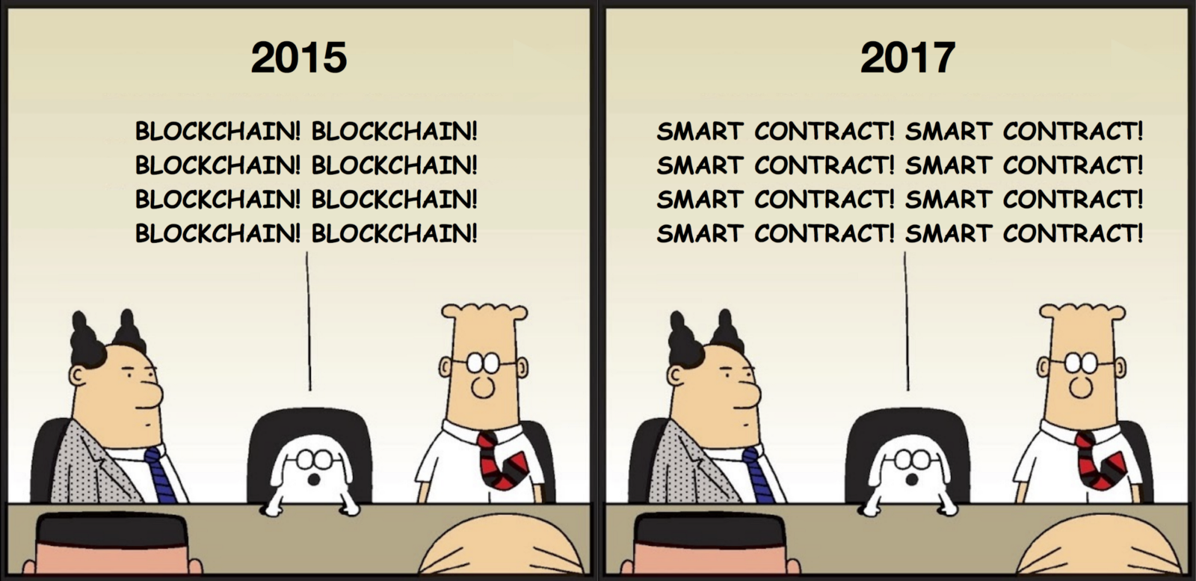
COMP6212 Computational Finance
Smart Contracts

Slide 2
Structure
General introduction- What are smart contracts
Non –Financial uses of Smart contracts
Smart contracts ecosystem
Oracles
What does a Smart Contract look like
UX Problems with cryptocurrencies

Slide 3
Contracts
A contract in the traditional sense is a binding agreement between two or more parties to do or not do something.
Each party must trust the other party to fulfil its side of the obligation.
They are a written or spoken agreement that is intended to be enforceable by law.
Take a small coffee shop
Contract with employees
Contract with landlord
Contract with suppliers

Slide 4
Contracts
The economies of the world are underpinned by a complex set of contractual agreements that are created and enforced by centralized organizations
like insurance companies, banks and courts.
Society and trade dependent upon centralized third-party organizations to maintain and enforce these contractual agreements.
The involvement of third-party might lead to security issues or fraudulent activities along with an increased transactional fee.

Slide 5
Smart contracts
Part of what is being called the blockchain 2.0
computer code stored inside of a blockchain
Encodes contractual agreements.
self-executing with the terms of the agreement written into code and stored and executed on the blockchain node.
introduced by Nick Szabo, a legal scholar, and cryptographer in the year 1994.
He concluded that any decentralized ledger can be used as self-executable contracts in code run on a blockchain- later called Smart Contracts

Slide 6
Smart Contracts
Currently smart contracts are not driven by artificial intelligence nor are they generally encode obligations and rights that are legally binding.
Smart contract code simply denotes software written in a programming language.
It acts as a software agent that fulfils certain obligations, exercises rights and may take control of assets within a distributed ledger in an automated way
It takes on tasks and responsibilities in the distributed ledger world by executing code that models or emulates contract logic in the real world, though its legal justification may be unclear.

Slide 7
Smart Contracts
So a Smart Contract is where the conditions written in the contract are both evaluated and excruciated by computer code, hence a trustless systems.
Example if Alex is to pay Chris £300 for a sofa once it is delivered.
The code determines if the conditions are true:- the sofa has been delivered, if Alex has paid Chris
The advantage here is that there is no middle person, the smart contract is executed is a timely fashion and objectively.
The power of the smart contract is in the execution of the agree-to-consequences, not to any intelligence innate intelligence in the smart contract.

Slide 8
Smart Contracts
Corda smart legal contracts, not only consist of code but additionally are allowed to contain legal prose.
Thus above smart legal contracts are legal prose that are formulated in a way that they can be expressed and implemented in smart contract code.
This gives the code legitimacy that is rooted in the associated legal prose.
Such a construct is called Ricardian Contract.
Corda was explicitly designed to account for the highly regulated environment of the financial services industry.
Notes:
https://en.wikipedia.org/wiki/Ricardian_contract

Slide 9
Smart Contracts
definition is from RSK, a smart contract platform:
Smart contracts are contracts whose terms are encoded in computer language instead of legal language.
Smart contracts can be executed… so that the terms of the contracts are automatically enforced by a protocol that all nodes in the network follow.
A smart contract can be fully autonomous if all the objects referred (such as currency, payments, obligations, property titles, assets, licenses) have a digital representation in the platform.

Slide 10
Smart contracts
The heart of a smart contract is automated performance
It is a program that containing certain inputs and executing a set of instructions in order to come to one of many predetermined outcomes
a set of rules which are agreed upon by the involved parties
encoding and automatically performing complex agreements,
assisting with identity verification
reducing cumbersome documentation
Smart contracts on a blockchain combines performance with an immutable record of what has actually being performed.
Allows the exchange anything of value including money, shares, property etc,
in a transparent manner eliminating the need for a middleman and keeping the system conflict-free.

Slide 11
A common analogy is a vending machine
A vending machine operates algorithmically;
you provide the source input of money and product selection, which the machine takes as input
Then executes on a rule automatically to produce the output.
The same instruction set will be followed every time in every case.
When you deposit money and make a selection, the item is released.
There is no possibility of the machine not wanting to or not feeling like complying with the contract, or only partially complying.

Slide 12
A joint investment
Four different people pool their money to make a joint investment.
A smart contract takes any interest that is created, divide it into four and send each amount to the corresponding wallets of the different stakeholders.
A smart contract is an account on the blockchain that is controlled by code instead of by a user.
it is immutable meaning the code cannot be changed
Ensuring that all participants in the investment will get their share automatically.
The code dictates how the processing will take place and no individual has the power to change it, no individual, no organization can censor, alter or manipulate it.

Slide 13
Non –Financial uses of Smart contracts

Slide 14
Smart contracts
Other potential areas for smart contracts include:
supply chain management, and in particular, combining blockchain, smart contracts and identification technology (e.g. RFID) to ensure that inputs are tracked throughout the entire supply chain.
Including in relation to authentication and payments;
real estate transactions and land registration;
payment of insurance claims, and automation of certain policies (e.g. life insurance);
transfer of assets under certain specified circumstances;
provision of licences;
management of intellectual property rights; and
automatic ordering of goods and services, including in a machine-to-machine context.

Slide 15
Smart contracts - Smart Property
A combination of smart contract with blockchain-encoded property
an asset is registered as a digital asset on the ledger
ownership is controlled via blockchain encoded contractual agreements.
For example, a pre-established smart contract could automatically transfer the ownership of a vehicle title from the holding company to the individual owner when all the loan instalments have been paid.
One example of such an IoT Blockchain system is Slock.
it a door lock that is connected to a smart contract on the blockchain which controls when and who can open the lock.
This enables anyone to rent, sell or share their property without a middleman.
Parking spots can be sublet on demand.
Someone with 20 bikes in Southampton could rent them out

Slide 16
Smart Property - advantages
Automation is more efficient by removing time and costs associated with managing and enforcing contracts
Increased numbers of exchanges (transactions),
enabling a service economy where ownership is replaces by temporary usage through the on-demand provisioning of services.
Reduce corruption,
the code is transparent in its workings and automatically executed this leaves little room for a centralized organization to alter it to their advantage.
Reduce dependency upon centralized organizations
people can set up there own contractual agreements peer-to-peer, thus limiting the power of centralized organizations.
Smart contracts guarantee a very specific set of outcomes that are predetermined beforehand, enabling all parties to know exactly what will happen and when.

Slide 17
Smart Property - Problems
Automating the execution of a contract that is dependent upon formal rules with well-specified inputs leaves little room for a multiplicity of eventualities where the rules may need to be slightly altered because of unforeseen circumstances.
the bikes could simply stop working when you are miles away from home.
an on-demand car shut the user out if they have not paid the but is not able to know if this is a life or death situation.
many unpredictable and unforeseen events do occur and rules sometimes need to be flexible and adapt to accommodate.
Hence the need for human oversight as people are much more capable of judging and responding appropriately to complex unforeseen eventualities.
So there may need to be some form of governing body to intervene.

Slide 18
Smart contracts ecosystem

Slide 19
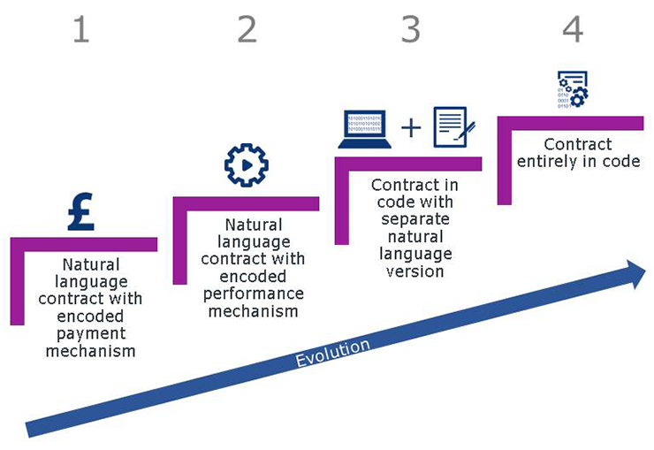
We are still in the early stages of developing wholly independent smart contracts without any natural language.

Slide 20
Smart contracts
A natural language contract, with words on pages, but with certain functions encoded in digital form. Areas that are clearly delineated into black and white functions such as payments are areas that lend themselves to automation.
A natural language contract, with other functions encoded in digital form, not just "black and white" functions – for example, performance of certain subject matter obligations under the contract (beyond payments). This would be a natural and incremental progression from stage 1.
A contract in code supplemented by natural language – for example, a natural language systems procurement contract may have certain schedules sitting under it being entirely automated (such as Service Levels and Service Credits-related schedules).
A contract entirely in code that dispenses with the natural language contract. This contract would be a piece of code that is legally recognised and enforceable, on a standalone basis.
Currently, smart contracts mostly sit between steps 1 and 2. We are a long way away from pieces of code sitting entirely independently as a contract, without any reference to a natural language document.

Slide 21
Smart contracts
At present smart contracts carry out what they are programmed to do.
They do not think independently or provide any reasoned analysis, and do not address "grey areas" or contain the flexibility that parties will frequently expect from certain kinds of contracts.
For example – in a typical procurement agreement, the supplier may offer the customer the benefit of an indemnity for defective products. That is a difficult clause to encode – the indemnity would operate when a certain event happens, but the scope of the indemnity (and the amount that is payable) will likely be subject to the individual facts in question, and may also be subject to court interpretation.

Slide 22
Smart Contracts
A ‘Smart Contact’ would need to act as a judge
Take the spirit of the contact and make rulings that are fair even in the circumstances are not clear and taking into account extenuating circumstance
However our smart contracts do not currently have that intelligence as yet.
Our contacts exactly follow the rules encoded and cannot take into account circumstance or ‘spirit of a contract’
The lack of ambiguity means we can write a contract that is trustless.
Ethereum's Smart contracts are Turing-complete
Allows for more complicated contracts, but making it difficult to analyse.
Complex contracts are more difficult to secure- making secure that every possible transaction is execrated in the way the author indented.
Bitcoin only allows simple contracts for this reason

Slide 23
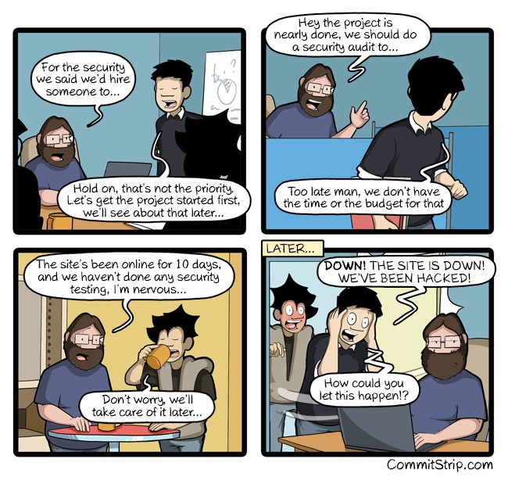
Smart Contracts

Slide 24
Smart Contracts
Ethereum’s leaves it to the contract writes to make sure the coteract is correct.
Remember the principle in Ethereum is that Code is law, if you screw it up, it is your problem
ERC20 and ERC721 standards are frequently used to develop smart contract
But do not need to be Turing-complete
Hacked contract
User could deposit money into a DAO and get returns -£150M in ETH was raised
Someone figures out a security flaw (loop-hole) in the contract –it id nt act as the author intended and was able to drain the fund
Ethereum has now decided that code is not law, and reverted all the money that went into the DAO
the contract writers and investors got it wrong and the Ethereum developers decided to bail them out.
Notes:
DAO =Decentralized Autonomous Organization”
A fund was created in Ethereum as a way to show what the platform could do.

Slide 25
Oracles

Slide 26
Smart contracts
Smart contracts require input values and only act if certain predefined conditions are met.
When a particular value is reached, the smart contract changes its state and executes the programmatically predefined algorithms, automatically triggering an event on the blockchain.
Thus the workings of the overall contract can only be as good as the inputted data if false data is inputted to the system them false results will be output.
Blockchains cannot access data outside their network and thus requires some form of trusted data feed as input to the system, what may be called an oracle.

Slide 27
Smart contracts
An oracle is a data feed, provided by an external service, and designed for use in smart contracts on the blockchain.
Oracles provide external data and trigger smart contract executions when predefined conditions are met.
Such conditions could be any data like weather temperature, the quantity of items in stock, a successful payment, changes in the prices on the stock market, etc.
An oracle is then an agent that finds and verifies real-world occurrences and provides this information to a blockchain to be used by smart contracts.
Oracles are third party services which are not part of the blockchain consensus mechanism thus whether it be a news feed, website or a sensor, the source of information needs to be trustworthy.

Slide 28
Smart contracts
As an example, an online betting platform based on the blockchain that uses smart contracts to automatically execute payouts to people who have placed bets on sports matches.
The smart contract system would then have to be connected to a trusted oracle to provide it with the score of the matches.
This oracle would likely have to be associated with some trusted third party centralized organization, like a sports channel or Bloomberg for stock prices.
Notes:
However in the future through datafication and IoT pervasive sensing, this might also be automated given the use of advanced analytics.
Using automated oracles that draw data from a myriad of sources and complex analysis to find cross-correlations that provides a statistical assurance that for example an given event occurred or did not occur.

Slide 29
Smart contracts
Smart contracts are only as good as the data input that they receive.
If the data input is inaccurate at any stage, this could cascade as the smart contract progresses.
This is important with multiple input stages and stakeholders – e.g. a supply chain.
Example earlier there needs to be a system to say that Alex has received the Sofa
The legal systems in different jurisdictions have a long history of statutes and case law, that combine to give certainty to parties in different areas.
Some flexibility is required in interpretation – both by courts and contracting parties.

Slide 30
Smart contracts
That flexibility is a key feature of ensuring that commercial agreements operate as intended, and is (at present) not something that is offered by smart contracts, which by their nature is "black and white".
While computer coding tends to be unambiguous, traditional legal contracts are frequently drafted with some "flex room" in them,
e.g. expressions such as "reasonable efforts" and "material adverse change" have a long history of legal interpretation behind them, and in many cases helps parties resolve issues by not determining in advance exactly what the obligation involves.

Slide 31
Smart Contracts
Yet smart contract are still useful.
Alex has proof that they own the house, Chris pays for the house.
so the transfer of ownership is trustless, fast - execution by the platform, no need for judges, bureaucrats or title insurance.
This only really works of there is a definite link between the digital version of the hoarse ownership (token) and the physical ownership (land registry)
Hence the need for an Oracle- trusted third party
This applies to all likin of digital to physical assets
Regulated by the jurisdiction you/they are in and therefore you are trusting something other than just the smart contract.
Now we have the same trust problem of any contract.

Slide 32
Smart Contracts
In one way Oracles act as dumped down version of a judge
The “rights” to these digital assets are ultimately decided by some other authority and an Oracle needs to be trusted.
You still need to write a contract that encodes all possible outcomes with the subjectivity and risk of human judgment
A complex contract in which you still need to trust someone (the oracle)
Does work with and Oracle when there is a digital bearer instrument.
both sides of the trade need to not just be digital, but be bearer instruments
ownership of the token cannot have dependencies outside of the smart contracting platform
Now we have trustless systems for assets.

Slide 33
Simple Smart Contract

Slide 34
Smart contracts
First we must remember the basic system has accounts
Accessed through private code.
Transaction can be performed on an account to send/receive coins to add remove coins
Smart contract are really a special account that is controlled by code
Can perform transitions.
Can store a balance but often have zero balance (before and after transaction are completed)
Can be used to preform function/method
No administrator no private keys
DApps have a collection of contracts

Slide 35
Smart contracts
If you use Ethereum you can use the Mist browser on the test network.
Include the wallet
Get the test ether for free from Faucet (you need a GitHub account)
In Ethereum you can a shell contract-MyContract
You need to pay a fee for the ‘miner’ to process any transactions.
You now need to write the constructors
You need to write the methods
Development Environment for Ethereum (see solidity for list)
If you wrote the code in Mist you would lose it when you run it, so use remix
Notes:
https://github.com/ethereum/mist/releases
https://remix.ethereum.org use chrome

Slide 36
Smart contracts
Lets take a simple scenario.
You have 5 employs and you want to pay them an equal amount
Solidity Documentation: https://solidity.readthedocs.io/en/develop/
Remix IDE: https://remix.ethereum.org/
Rinkeby Testnet Faucet: https://faucet.rinkeby.io
Notes:
PLEASE NOTE: in order to get testnet ether just follow the directions on the faucet's website (link above). Instead of using GitHub gists, you now just post your address from one of your social media pages. (It will probably be easier for you than it was before) The reason they require you to do that is to prevent people from acquiring so much testnet ether that one could run attacks on the network... You're limited to like 20 ether every 3 days which is more than enough for testing.

Slide 37
Smart contracts-Payroll contract-Key Functions
Contract PayThem()
constructor () public payable{ //constructor
}
function () external payable{
// fall back function. When someone sends ether to the address of the contact //then this code is executed.
//payable keyword is required to receive/accept money (ether)
}
function salary() public{
} // this is the function an employee will use when they are ready to be paid, they call this address and function
Notes:
All we need is 3 simple funtions,.

Slide 38
Smart contracts
Contract PayThem()
address [] employees = [// array list of address of employees being pay, that can use the salary function, long strings];
uint EtherRecived = 0; // count of ether in the contractor
mapping (address => unit) paidAmount; // dictionary to see if they have been paid
To keep a tract of the money the contract receives we need a internal (private function)
function updatingEtherReceived () internal {
EtherRecived += msg.value; // in the wallet for the contract
}

Slide 39
Smart contract.
We then call the update function every time money comes into the contract
Constructor () public payable{ //constructor
updatingEtherReceived();
}
function () external payable{ // Fallback (default) function.
//Note cannot receive from using send //or transfer, but can from a function //call.
updatingEtherReceived();
}

Slide 40
Smart contract
We need to make sure the people are who they say they are.
modifier canTakeOut() { // check to see if they are an employee
bool employed = false ;
for (uint i=0; i< employees.length; i++){
if (employees[i] == msg.sender){
employed=true;
}
}
require (employed); //modifier syntax
_; //modifier syntax
}

Slide 41
Smart contract
function salary () canTakeOut() { // we have now added the modifier //to ensure that they are an employee
uint payGiven = EtherRecived/employees.length;
// the amount of money per employee
uint payTaken = paidAmount [msg.sender];
// the pay (0 or Amount) already given to an employee
uint pay = payGiven –payTaken;
// the amount paid this time
paidAmount[msg.sender] =payTaken + pay ;
// the total amount they have been paid, //update for next time

Slide 42
Smart contract-continued
function salary() canTakeOut() {
uint payGiven = updatingEtherReceived/employees.length;
uint payTaken = paidAmount [msg.sender];
uint pay = payGiven–payTaken;
if (pay >0){ // only if there is something to pay send it to them
msg.sender.transfer(amount);
}
paidAmount[msg.sender] =payTaken + pay ;
}

Slide 43
Deployment
We would then use (cut and past the code into ) Mist to deploy the contract.
It has it own address.
The employee calls the function salary and they will be paid.
Not instance

Slide 44
Design issues

Slide 45
Smart contracts - Minimal design
Rob Hitchens
“If a concern can possibly be addressed outside of a smart contract, then that’s what we should do.”
A well-crafted, minimalist contract only addresses concerns that cannot be addressed any other way.

Slide 46
Smart contracts - Minimal design
Blockchains and smart contracts are an extraordinary solution.
best to reserve it for extraordinary problems.
Use it to create trust and resolve uncertainty — nothing routine.
For example,
if you to just award points, countless examples existed long before blockchain.
if you want to prove that those points are always and will always be awarded by a disclosed formula, then you may need to make the formula an observable fact on the blockchain.
That would be solving for trust in the meaning of the scores.

Slide 47
Smart contracts - Minimal design
define the essential, enduring facts about the application,
provide the authoritative record of the facts that all participants can refer to in order to know they have the correct information, and
provide evidence of application integrity via immutable processes that prevent corruption in any form.
usually a good idea to make the complete state conveniently discoverable and completely auditable.
Beyond these core concerns are details that can be attended to by clients.
Notes:
This interpretation implies a narrow scope of concerns a smart contract should address. Contracts;

Slide 48
Smart contracts - Minimal design
An example of when not to use a smart contract
Consider the idea of sorting the data in the contract or finding a way to search it and filter it efficiently.
Yes it is very useful, perhaps even critical to the overall solution.
Yet high importance does not imply that the implementation belongs at the smart contract level.

Slide 49
Smart contracts - Minimal design
A smart contract should ensure that:
the data in the contract is completely discoverable,
state changes emit events in real time (they should), and
clients can inspect the state, listen to events, or both,
Hence the software clients can decide and implement any strangury they want to discover the facts they need in any given moment.
Minimalist contract design enables the construction appropriate client-side implementations without attempting to do the software client’s job for them.

Slide 50
Smart contracts - Minimal design
Knowing that a wide range of valid concerns will be attended to by off-chain processes greatly reduces the scope of functions that need to be coded inside a contract.
A minimalist contract addresses only concerns that cannot be addressed any other way.
Minimalism leads to clarity about exactly what the contract needs to prove and the minimum logic and data required to construct the proof.
Minimalism is the first defence against defects that might have non-trivial consequences.
The ideal is something so simple that there are obviously no defects.

Slide 51
Smart Contracts:-Plan for Failure
Smart contracts run automatically on the platform, this is both an advantage and a drawback.
We have a lack of execution control once the contract is deployed.
So we need highly secure code
Not practicable, as the Blockchain technology is still changing.
Leading to discovery of bugs and security issues.
Any non-trivial contracts will have bugs in it, we need to reposing to these gracefully
So we need software patterns to help protect contracts against unexpected events, such as Rate limiters and Exit strategies
Notes:
Also leads to new best practice

Slide 52
Smart Contracts:-Plan for Failure
As with any code.
Write a natural language description of the Contract and methods
Write test cases
Write the contract and methods
Write the constructors
Validate all arguments passed
Throwing appropriate exception when the arguments do not comply with expected input
Then write code to change the state of the contract.

Slide 53
Smart Contracts:-Interactions
When interacting with another contract we are handing over control.
So make sure we have finished with the original contract.
Example of an Auction Contract to set the end of the auction using a boolean.
function auctionEnd() public {
// 1. Checks
require(now >= auctionEnd);
require(!ended);
// 2. Effects
ended = true;
// 3. Interaction
beneficiary.transfer(highestBid);
}

Slide 54
Emergency Stop
Sometime we need to stop a deployed contract.
By trusted third parties named in the contract (contract Admin)
bool private stopped = false;
address private owner;
modifier isAdmin() { //check that the message is from the owner
if(msg.sender != owner) { //if not throw an exception
throw;
}
_
}
function toggleContractActive() isAdmin public
{
// You can add an additional modifier that restricts stopping a contract to be based on //another action, such as a vote of users
stopped = !stopped;
}

Slide 55
Emergency Stop
Sometime we need to stop a deployed contract.
Programmed rules that trigger the stop
modifier stopInEmergency { if (!stopped) _ }
modifier onlyInEmergency { if (stopped) _ }
function deposit() stopInEmergency public
{
// some code
}
function withdraw() onlyInEmergency public
{
// some code
}
The code defines two modifiers.
The first will stops the contract if bugs are found.
Note only the Admin can trigger the Boolean .
The second get around the fact that we are unable to withdraw money if there is a serious bug
Notes:
The above code example defines two modifiers. The first modifier makes sure that all actions in the contract are suspended when a bug is discovered – only the admin is able to toggle this boolean. However, we want to be able to withdraw funds in case of a severe bug; therefore, the second modifier is meant to allow you to withdraw funds.

Slide 56
Smart Contract :- Rate Limiters
The aim is to stop a methods in a contract being called so often that it effects the operation of the contract
Also used to limited the amount of Ether that an owner can withdraw, to prevent a rapid drain on funds.
Also the number of token issued over time say 5,000 per month.
contract RateLimit {
uint enabledAt = now;
modifier enabledEvery(uint t) {
require(now >= enabledAt, "Access is denied. Rate limit exceeded.");
enabledAt = now + t;
_;
}
function f() public enabledEvery(1 minutes) {
// some code
}
}
This a very basic rate limiter.
t is an amount of time to wait until the function can be called again.

Slide 57
Smart Contract:- Delay Actions
We want to slow things down to give contact owners time to react to a malicious event.
Often combined with a emergency stop to get money out.
struct RequestedWithdrawal {
uint amount;
uint time;
}
mapping (address => uint) private balances;
mapping (address => RequestedWithdrawal) private requestedWithdrawals;
uint constant withdrawalWaitPeriod = 28 days; // 4 weeks

Slide 58
Smart Contract:- Delay Actions
function requestWithdrawal() public {
if (balances[msg.sender] > 0) {
uint amountToWithdraw = balances[msg.sender];
balances[msg.sender] = 0; // for simplicity, we withdraw everything;
// presumably, the deposit function prevents new deposits when withdrawals are in progress
requestedWithdrawals[msg.sender] = RequestedWithdrawal({
amount: amountToWithdraw,
time: now
});
}
}
function withdraw() public {
if(requestedWithdrawals[msg.sender].amount > 0 && now > requestedWithdrawals[msg.sender].time + withdrawalWaitPeriod) {
uint amountToWithdraw = requestedWithdrawals[msg.sender].amount;
requestedWithdrawals[msg.sender].amount = 0;
if(!msg.sender.send(amountToWithdraw)) {
throw;
}
}
}
Notes:
https://coursetro.com/posts/code/102/Solidity-Mappings-&-Structs-Tutorial

Slide 59
Smart Contracts: Limit the Balance
Monitor the amount of Ether, rejecting payments that exceed the predefined maximum.
contract LimitBalance {
uint256 public limit;
function LimitBalance(uint256 value) public {
limit = value;
}
modifier limitedPayable() {
require(this.balance <= limit);
_;
}
function deposit() public payable limitedPayable {
// some code
}
}
We use a modifier to limit the balance inside the contract.
We apply it to the deposit function as this is where the money is being accepted.

Slide 60
UX Problems – Learn from the Web

Slide 61
UX Problems - No consistent design of a digital wallet
Smart contract requires paying with cryptocurrency.
no solution that hosts all the main currencies at once (even the top 30).
User interfaces are designed differently and applications vary in the capabilities they offer.
users must re-learn how to do things each time they use a different wallet or payment processing system.
Notes:
Imagine getting a different browser for every site, or a different remote control for every TV channel. Think about how weird it would be if someone had to re-learn how to use a credit card every time they used a different card or tried to pay at a different store, and you get an idea of the blockchain world as it is today.

Slide 62
UX Problems - Users require knowledge of cryptocurrency.
Users need to know about their private wallet key,
how long it takes to confirm transactions,
How much transaction fees cost.
Decentralized and users in essence become their own bank.
The concept of managing keys can be complex and can require a high learning curve.
Receiving and sending transactions also require user work.
Notes:
Using money does not require knowledge of minting and circulating bills. But to use smart contracts, users need to know a lot about cryptocurrencies before utilizing blockchain technology.
when someone sends a crypto coin over the blockchain, they’re sending them to a hashed version of what’s known as the “Public Key.”
There is another key hidden from users called the “Private Key.”
Basically, you give people that want to send you money your public key, but don’t tell outsiders about your private key (even not to your grandma).
Smart contracts require extra effort because they place the workload on the user who has to download a cryptocurrency wallet application before making purchases.

Slide 63
UX Problems – poor payment network.
cryptocurrency is a poor payment network,
Yet revolutionary breakthrough as an arbiter.
bitcoin transactions have and are more expensive for the user than nearly every major centralized alternative.
On-chain transactions never have been well suited for in-store purchases and only work reasonably well for online purchases, sometimes.
Notes:
Crypto currency transactions, even at the very beginning, have always been unreliable and in comparison to credit card or PayPal. Today, the bitcoin average transection fee is as high as $0.575, which is more expensive for the user than nearly every major centralized alternative.

Slide 64
UX Problems – Lack of regulations
An advantage but also a problem
No governmental way to enforce the legal use of blockchain-based, decentralized apps and cryptocurrencies.
Wild, Wild West out there -new and unregulated market,
Hackers lure uneducated users to send their info such as the private key to take all of their money or even steal their identity.
Uneducated users can do all kind of mistakes like sending their money to the wrong address, so it disappears.
Instead of creating the future of commercial systems, some people are using the system poorly or fraudulently.
Smart contract’s UX designers would have to find, using the given technology, solutions that would ensure and secure it users.
Notes:
Cryptocurrencies and blockchain technology without regulation offers a snapshot of what the days before banking looked like.
Otherwise, your grandma is going to send her smart contract will to the wrong heir.

Slide 65
Solution
Smart contract’s UX designers would have to find, using the given technology, solutions that would ensure and secure it users.
The people that are working to solve this kind of problems today are developers, cryptographers and mostly people with a technical background.
UX designers now create a tailor-made experiences for its users.
Before UX, the focus of creation the product was on the techie side of the team.
Asked to make stuff look pretty, not functional and easy to operate like today.
UX designers should be in the process of creating blockchain and smart contracts products.
Educating their users on the possibilities of micro-transactions, being your bank, using trustless systems and other things that aren’t possible with cash or credit cards.

Slide 66
Summary
We have provide a quick overview of smart contracts.
We have tried not to focus on one platform, but the example is in Ethereum.
Smart contracts are not yet at the quality of a legal contract but getting there.
Smart contracts are vulnerable due to miss coding so there is still research required in to the validation and verification of smart contracts.

Slide 67
Other links
Learning Solidity with a Simple Fundraising Smart Contract
Developing Ethereum Smart Contracts for Beginners 2017

